Slide 1




OCTOBER 2024
CHIEF
OPERATIONS
OFFICER
CARMELITE
FRIARS
Candidate brief

Slide 2

INFORMATION FOR CANDIDATES
The Centre for Applied Carmelite Spirituality (CACS) is dedicated to deepening spiritual growth and enriching lives. We offer an array of programmes, including retreats, online spiritual accompaniment, and educational initiatives, serving thousands of individuals globally.
Carmelite spirituality, rooted in contemplation, community, and service, speaks to the heart of our mission. As we navigate a rapidly changing world, the timeless values of Carmelite spirituality offer a beacon of hope and a path to personal and communal transformation.
To further our mission, we have created the new Chief Operating Officer (COO) role. This position is crucial for the expansion and sustainability of our operations, ensuring they remain vibrant and relevant. The COO will spearhead our efforts to innovate, manage, and secure the financial viability of our offerings, working closely with a diverse range of stakeholders.
This is an exciting opportunity for a dynamic and visionary leader to:
  Drive the growth and development of a wide range of spiritual and educational programmes.
  Collaborate with a dedicated team and build a global network of partners.
  Enhance the visibility and impact of Carmelite spirituality.
  Ensure the financial sustainability of our programmes through strategic planning and innovative approaches.
  Be a part of a senior leadership team in a mission-driven organisation committed to spiritual enrichment.
Deadline
All submissions should be received by 15 November, 2024. Please apply to director.cacs@carmelite.org.uk with a cover letter/expression of interest and resume/CV, in the same document. The selection process will take place in November, with the candidate ideally starting in January 2025.
Compensation and Rewards
The successful candidate can expect a salary between £28,000 and £38,000 depending on experience. CACS offers a comprehensive total compensation package including pension matching programme, generous holidays, and professional development opportunities.
Location and Flexibility
The COO is based at the Carmelite Priory in Oxford, UK. Applicants must have the right to work in the UK. (We are pleased to offer flexible working conditions; this role is hybrid with a minimum of two days in-office attendance per week. Some travel will be required for in-person meetings, workshops, and events.)
Mentoring and Development
CACS is committed to life-long learning for all team members. Ongoing mentoring will be available to facilitate the COO’s career development, and appropriate training and skill-building opportunities will be provided.
Diversity and Inclusion
We believe diversity is key to excellence and actively encourage applications from individuals of all backgrounds, including those commonly underrepresented in spiritual and non-profit sectors.
2

Slide 3
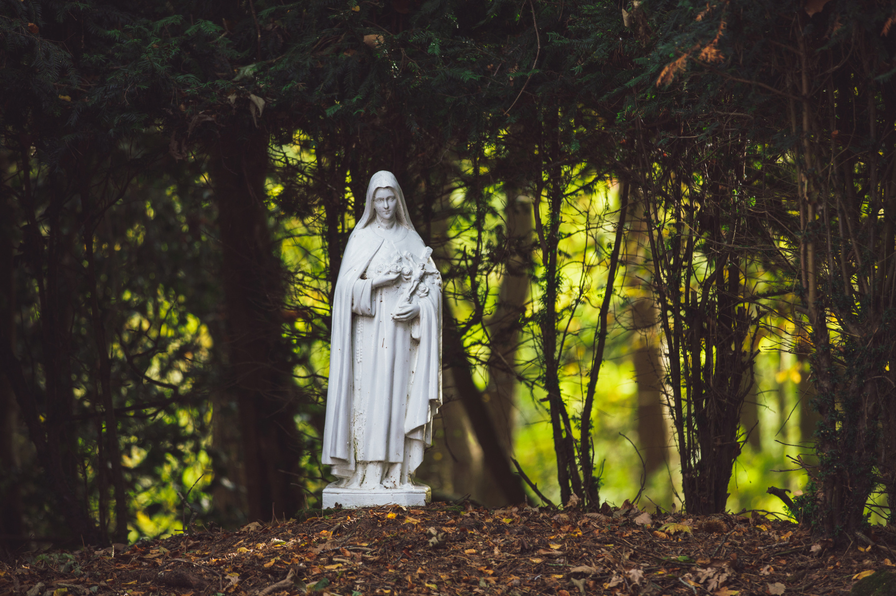
2018
THE CENTRE FOR APPLIED CARMELITE SPIRITUALITY (CACS)
Draft for discussion
EST.
Our mission is to foster spiritual growth and community through the rich traditions of Carmelite contemplation, community, and service. We work with a network of Carmelite communities, lay members, and spiritual seekers worldwide to advance our collective mission.
Our Shared Goals
  Develop and sustain programmes that promote Carmelite spirituality.
  Ensure the financial sustainability of our offerings through strategic planning and innovative approaches.
  Foster a global community dedicated to spiritual growth and mutual support.
  Promote awareness and understanding of Carmelite traditions in contemporary contexts.
  Support personal and communal transformation through spiritual and educational initiatives.
CACS has grown tremendously since its founding in 2018. Starting with two residential courses (School of Prayer and Prayer Guides), CACS now runs four flagship courses, lecture series, annual conferences, spirituality summits and summer schools, retreat-pilgrimages, many self-study courses, online tutor led courses, an online subscription media library, the Carmelitarum App, Carmelitarum streaming TV, new publication projects, Companions-In-Carmel Communities, and many more. The COO will oversee the varied operations of CACS and ensure all its interconnected parts work together.
History
The Carmelite Friars, belonging to the Order of Discalced Carmelites in the UK, are part of a Catholic religious order founded in the 12th century on Mount Carmel. The Order places a strong emphasis on contemplative prayer, simplicity, and living in community. They follow the Rule of St. Albert and are known for their commitment to poverty, chastity, and obedience. The Discalced branch, which means "shoeless" or barefoot, was reformed in the 16th century to return to the order's original contemplative roots. Today, Carmelite Friars continue their mission through prayer, spiritual guidance, and various ministries, embodying a life of prayerful devotion and service to God.
Our Spirituality
The core of Carmelite spirituality is a journey of the heart. The Carmelite way of life is a prophetic vocation, which, in the light of the prophet Elijah’s example (1Kings 19), means living in the presence of God and bearing witness to him. It combines a life of union with God and a life of apostolic activity. In addition, Carmel belongs totally to Mary: Devotion to Mary as Mother and as a “sister in the faith” is characteristic of Carmelites.
The charism of the Carmelite Order is contemplation. Contemplation encompasses prayer, study, community, and service.
3

Slide 4
Our Rule of Observance
Our ‘pattern of life ’is outlined in the Rule of St Albert. This remains basically the rule that governs our life today, calling us principally:
  To live in allegiance to Jesus Christ, serving him with a pure heart and a good conscience, looking to Him alone for salvation, as we obey our superior in a spirit of faith.
  To reflect on Our Lord in the Scriptures, so that the word of God may be always in our hearts and on our lips, and guide us in everything we do.
  To come together daily for the celebration of prayer and the Eucharist.
  To put on the armour of God, faith, hope and charity, in a spirit of evangelical self-denial and a generous commitment to work.
  To enter into a genuine sharing of life in fraternal love, having at heart the good of the community and the salvation of souls.
  To hold everything in common ownership.
  Above all, to lead a life of unceasing prayer in silence and solitude, in accordance with the gospel which tells us to watch and pray.
  To use prudent discretion in all that we do.
Programmes
A few representative successes over the past years have included:
  The Spiritual Direction Formation Programme builds on an interpretation of the experience of journeying towards intimacy with God as expressed in the life of the Carmelite saints and deriving principles from this for the growth and flourishing of the spiritual life.
  The School of Prayer is intended for those who realise the importance of prayer in their lives and are seeking a deeper relationship with God and support and encouragement in their search.
  The School of Scripture course takes a comprehensive look at the structure and contents of the Bible, i.e., both the Old and the New Testaments, their historical background and the centuries-old tradition of Biblical interpretation (aka ‘exegesis’).
  The School for Prophets aims to hear and heed God’s voice from within the tumult of this time. Practicing the prayer, study, and silent receptivity exemplified by the prophets, school participants examine the world as God sees it and discern ways to speak God’s truth, for both what is needed and possible.
  Online-directed retreat is a time for people to process things in their spiritual journeys with a guide. Some people may want to take a few days out just to pray and reflect.
  without needing to travel to a retreat centre but to do so from the comfort of their homes.
  In-person directed or Private Retreats allow time away from busy schedules to relax, pray, and reflect away from home. The length of stay is flexible. Those who wish may have a spiritual director accompany them during their retreat experience can. The spiritual director will be available at a fixed time built into the individual’s timetable.
4

Slide 5
CHIEF OPERATING OFFICER
The COO’s objective is to promote the richness of Carmelite teachings within the broad perspective of Christian spirituality to a diverse range of audiences through a range of programmes and initiatives offered by CACS. The aim is to support individuals in developing a deeper understanding of themselves through the experience of Carmelite spirituality, as well as helpful aids towards a deeper knowledge of the spiritual life that may be beneficial vocationally or simply for personal enrichment.
Roles and Responsibilities
As part of the senior leadership team, the COO will report to the Prior. The position will focus on:
Strategic Leadership
  Develop and execute a comprehensive strategic plan aligned with the mission and vision of CACS.
  Identify opportunities for innovation and expansion to ensure CACS remains at the forefront of spiritual and educational programming.
  Collaborate with the senior leadership team to set and achieve long-term organizational goals.
Operational Management
  Oversee the daily operations of CACS, ensuring efficiency and effectiveness across all departments.
  Implement and monitor operational policies and procedures to improve organisational performance.
  Ensure the integration and alignment of various programmes and initiatives to foster a cohesive operational strategy.
Financial Performance and Sustainability
  Develop and manage the annual budget, ensuring financial sustainability and growth.
  Monitor financial performance, generating key performance indicators and financial reports for the leadership team and stakeholders.
  Identify and implement strategies to secure funding and resources, including fundraising, grants, and partnerships.
Programme Development and Innovation
  Lead the development and execution of new and existing programmes, ensuring they meet the needs of diverse audiences and adhere to CACS’s standards of excellence.
  Foster a culture of continuous improvement and innovation within the programmes team.
  Evaluate the effectiveness of programmes and implement changes based on feedback and performance data.
Compliance and Best Practices
  Ensure all operations and programmes comply with relevant laws, regulations, and best practices.
  Implement and uphold standards of excellence in programme delivery and operational management.
  Conduct regular reviews and audits to ensure compliance and continuous improvement.
5

Slide 6
Marketing and Promotion
  Develop and oversee the implementation of comprehensive marketing strategies to increase the visibility and impact of CACS programmes.
  Work closely with the communications team to promote CACS offerings through various channels, enhancing brand recognition and engagement.
  Represent CACS at conferences, events, and other public forums to promote its mission and programmes.
Stakeholder Engagement and Relationship Management
  Build and maintain strong relationships with key stakeholders, including donors, partners, and participants.
  Engage with the wider Carmelite community to foster collaboration and support for CACS initiatives.
  Serve as a primary point of contact for major stakeholders, ensuring their needs and expectations are met.
Team Leadership and Development
  Lead, mentor, and develop the programmes and operations teams, fostering a collaborative, high-performance culture.
  Provide ongoing training and development opportunities to support team members’ professional growth.
  Encourage a positive, inclusive work environment aligning with CACS’s values and mission.
Candidate Profile
To succeed in this role, CACS believes that the new COO should ideally possess some combination of the following attributes:
  Proven Leadership in Operations: Demonstrated success in a senior operational role within a non-profit, educational, or spiritual organisation, including experience in developing and managing complex programmes.
  Strong Financial and Fundraising Acumen: Extensive experience in financial management, including budget setting, monitoring, and financial reporting, as well as raising funds for policy, advocacy, infrastructure, and/or research programming. Skilled in managing funding relationships with a range of donors and supporting teams on grant management and compliance.
  Strategic Marketing and Promotion Expertise: Proven ability to develop and execute effective marketing and promotional strategies to enhance visibility and engagement with programmes.
  Exceptional Interpersonal and Communication Skills: Outstanding written and verbal communication skills, with a demonstrated ability to work collaboratively and build strong relationships with diverse stakeholders.
  Passion for Mission and Values Alignment: A deep understanding or appreciation of Carmelite spirituality, with a commitment to fostering spiritual growth and community development and strong alignment with the mission and values of CACS.
6

Slide 7
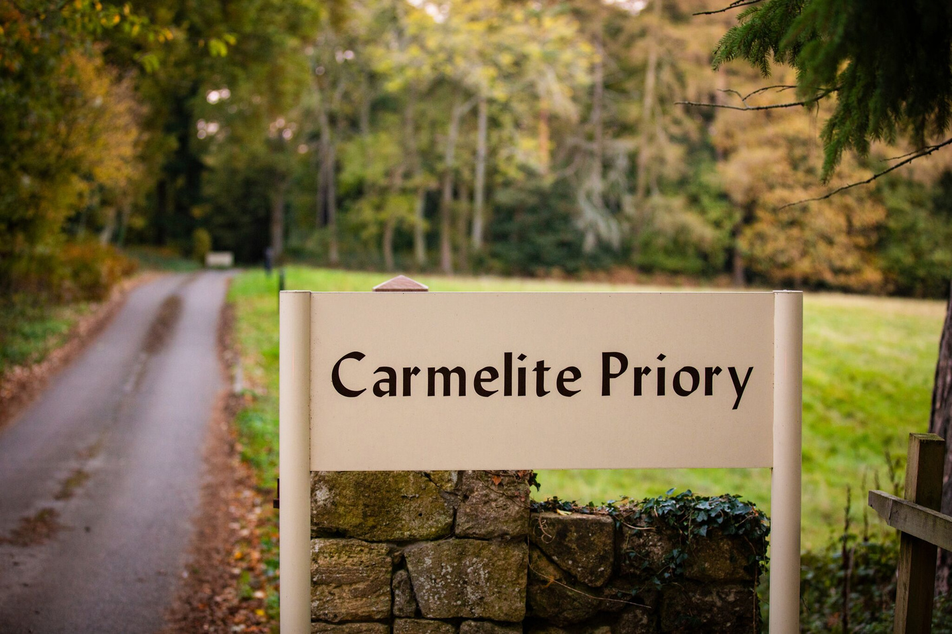
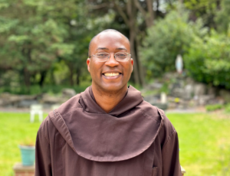
Leadership Bio: Fr Alexander Ezechukwu, OCD
Father Alex is a Carmelite priest and serves as the Prior of the Carmelite community at Boars Hill, Oxford. He is a trained spiritual director with many years of pastoral experience in guidance in spiritual life. Father Alex holds a Licence in Sacred Scripture from the Pontifical Biblical Institute, Rome. He also serves as the co-director of CACS.
“HUMILITY CANNOT EXIST WITHOUT LOVE, AND LOVE CANNOT EXIST WITHOUT HUMILITY. IT IS IMPOSSIBLE FOR THESE VIRTUES TO EXIST EXCEPT WHERE THERE IS GREAT DETACHMENT FROM ALL CREATED THINGS”
Teresa of Ávila, The Way of Perfection
7

